Slide 1



MAHAVEER INSTITUTE OF SCIENCE AND TECHNOLOGY
SEMINAR ON
HEART DISEASE
PREDICTION USING
MACHINE LEARNING
PRESENTED BY
YASMEEN BEGUM
K.HIMA BINDU
SUGGESTED BY
SIDDI SRINIVAS SIR

Slide 2

ABSTRACT
Heart related diseases are the main reason for a huge number of death in the world
So, there is a need of reliable, accurate and feasible system to diagnose such diseases in time for proper treatment
Machine Learning algorithms and techniques have been applied to various medical datasets to automate the analysis of complex data.
Many researchers have been using several machine learning techniques to help the health care industry in the diagnosis of heart related diseases
Keywords : SVM , KNN , Naïve Bayes , Decision Trees (DT) , Random Forest (RF)

Slide 3

CONTENTS
INTRODUCTION
OBJECTIVE
METHODOLOGY
EXISTING SYSTEM
LIMITATION OF EXISTING SYSTEM
PROPOSED SYSTEM
ADVANTAGES OF PROPOSED SYSTEM
MODULES
HEART DISEASE DATASET
SYSTEM ARCHITECTURE
ALGORITHM USED
SYSTEM DESIGN
SYSTEM TESTING
OUTPUT SCREEN
HARDWARE REQUIREMENTS
SOFTWARE REQUIREMENTS
APPLICATIONS
CONCLUSION

Slide 4
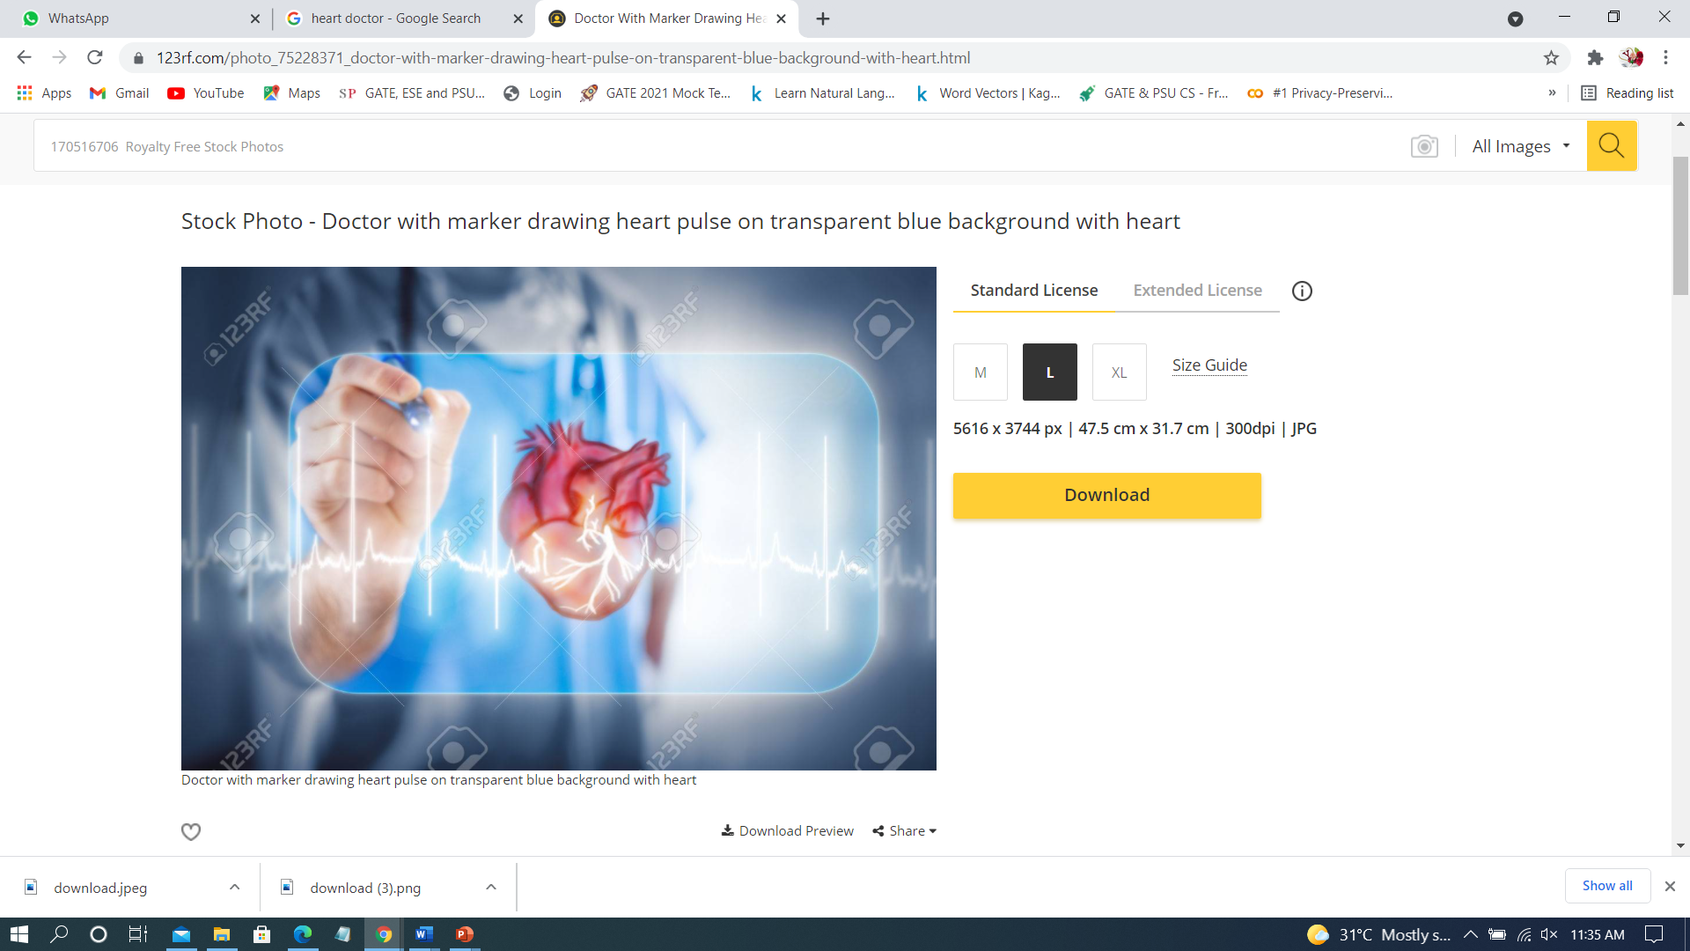
INTRODUCTION
Cardiovascular disease is one of the most fatal condition in the present world
By utilising the patient medical record as a dataset it will predict the heart disease.
Attributes such as Age, Sex , Blood pressure , chest pain etc.
By using Machine Learning algorithms it will predict the result of heart disease

Slide 5

OBJECTIVE
To study about Heart Disease Prediction using various Machine Learning algorithms
To identify the important attributes of Heart Disease.
To study the research on algorithms for comparing accuracy.
To provide accurate result using Dataset.

Slide 6
METHODOLOGY
INPUT HEART DISEASE DATA
PREPROCESSING
USING MACHINE LEARNING ALGORITHM SUCH AS KNN,NAÏVE BAYES,SVM,DECISION TREES
CALCULATING THE ACCURACY

Slide 7

EXISTING SYSTEM
Heart disease is even being highlighted as silent killer which leads to death of a person without obvious symptoms
Very few systems use the available clinical data for prediction purpose.
Diagnosis of a condition solely depends upon the doctors intitution and patients records.

Slide 8

LIMITATION OF EXISTING SYSTEM
Detection is not possible at earlier stage.
Practical use of collecting data is time consuming.

Slide 9

PROPOSED SYSTEM
Dimensionality Reduction involves selecting a mathematical representation of data.
The data considered for a task or a problem, may consists of a lot of attributesor dimensions.
A large number of attributes, or features, may affect the computational complexity .
Thus, Dimensionality Reduction is a very important step considered while building any model.

Slide 10

ADVANTAGES OF PROPOSED SYSTEM
Patient can search for doctor’s help at any point of time.
Patient can talk about their Heart Disease and get instant diagnosis.
Doctors get more patients online.
Very useful in case of emergency.

Slide 11


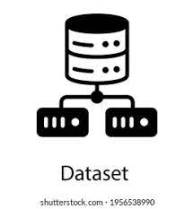
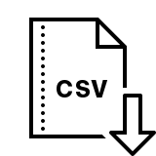
MODULES
User
System
Dataset

Slide 12
HEART DISEASE DATASET ATTRIBUTES
• age - age in years
• sex - sex (1 = male; 0 = female)
• chest pain - chest pain type (1 = typical angina; 2 = atypical angina; 3 = nonanginal pain; 4 = asymptomatic)
• blood pressure - resting blood pressure (in mm Hg on admission to the hospital)
• serum cholesterol - serum cholesterol in mg/dl
• fasting blood sugar - fasting blood sugar > 120 mg/dl (1 = true; 0 = false)
• electrocardiographic - resting electrocardiographic results (0 = normal; 1 = having ST-T; 2 = hypertrophy)
• max heart rate - maximum heart rate achieved
• induced angina - exercise induced angina (1 = yes; 0 = no)
• ST depression - ST depression induced by exercise relative to rest
• slope - the slope of the peak exercise ST segment (1 = upsloping; 2 = flat; 3 = down sloping)
• no of vessels - number of major vessels (0-3) colored by fluoroscopy
• thalassemia - 3 = normal; 6 = fixed defect; 7 = reversable defect

Slide 13
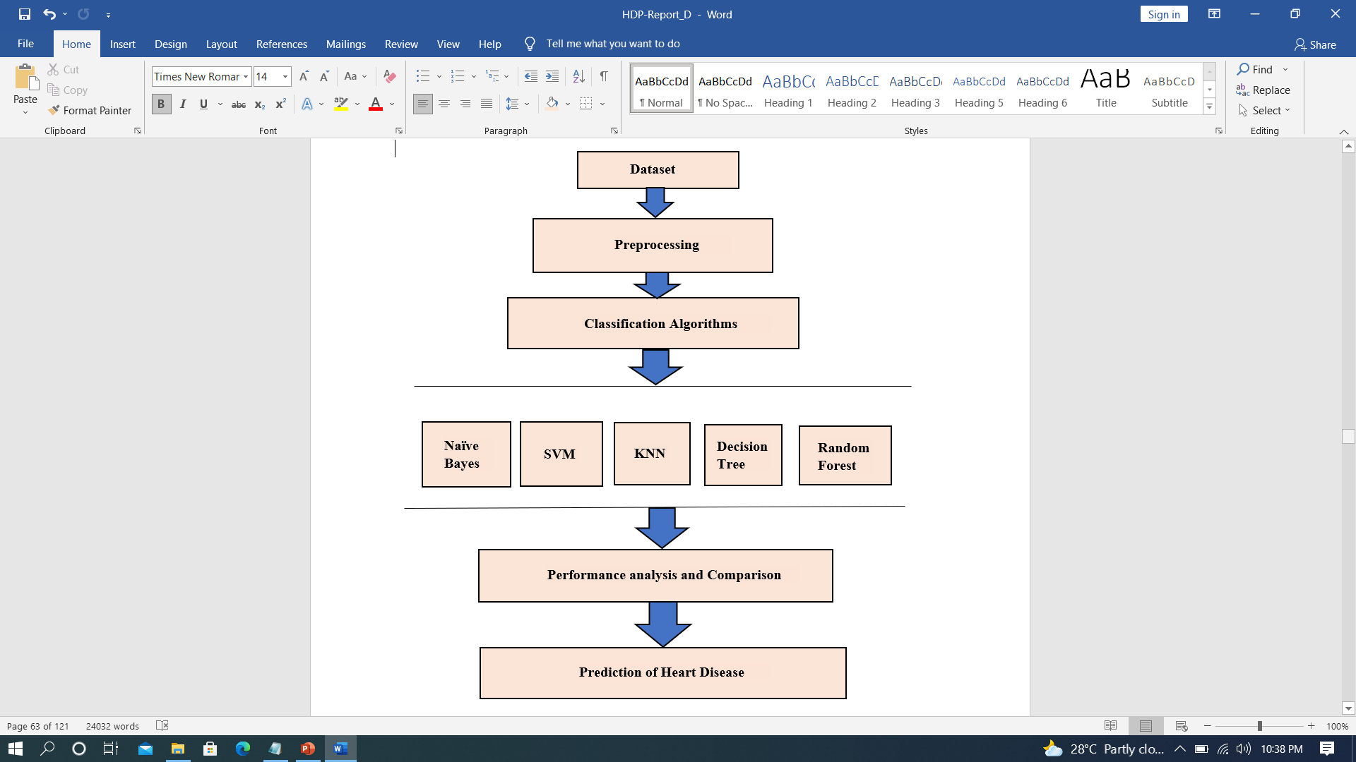
ARCHITECTURE

Slide 14
ALGORITHMS
Naive Bayes
Support Vector Machine
K – Nearest Neighbour
Decision Tree
Random Forest
NAÏVE BAYES
SUPPORT VECTOR MACHINE
Machine Learning algorithms
RANDOM FOREST
K-NEAREST NEIGHBOUR
DECISION TREE

Slide 15
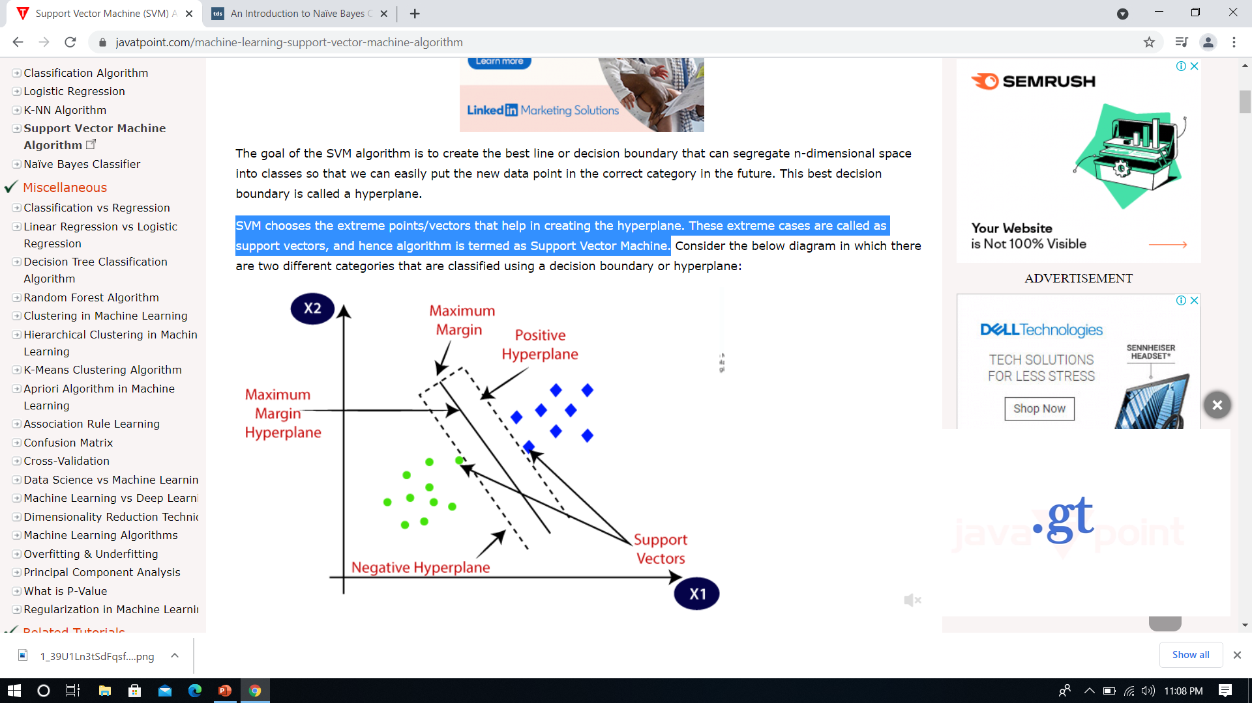
SUPPORT VECTOR MACHINE
It is a classification method. In this algorithm, we plot each data item as a point in n-dimensional space(where n is number of features you have) with the value of each feature being the value of particular coordinate.

Slide 16
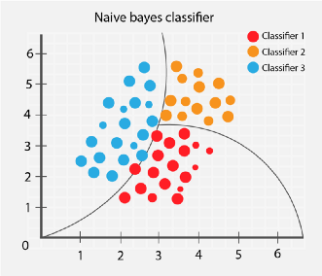
It is a simple technique for constructing classifier. It is a probabilistic classifier based on bayes theorem with strong (naïve) independence assumption between the features P(B|A)P(A) P(A|B) = P(B) using bayes probabilistic terminology ,the above equation written as prior x likelihood posterior = evidence
NAÏVE BAYES CLASSIFIER

Slide 17
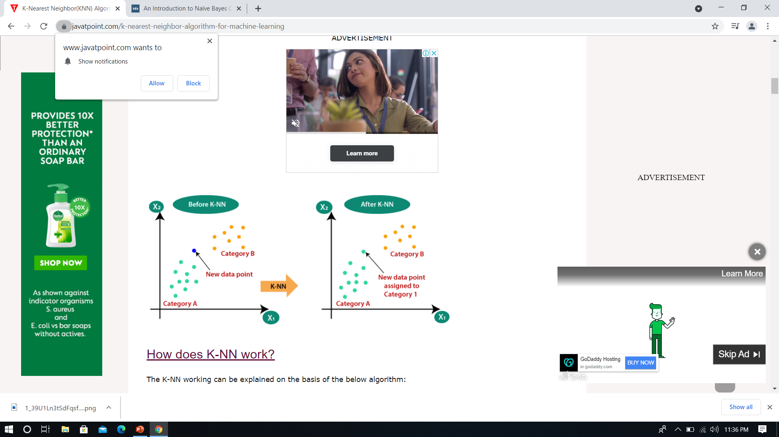
K NEAREST NEIGHBOUR
It can be used for both classification and regression problems.
In both cases ,the input consists of the k closest training examples in feature space.
The output depends on whether K-NN is used for classification or regression

Slide 18
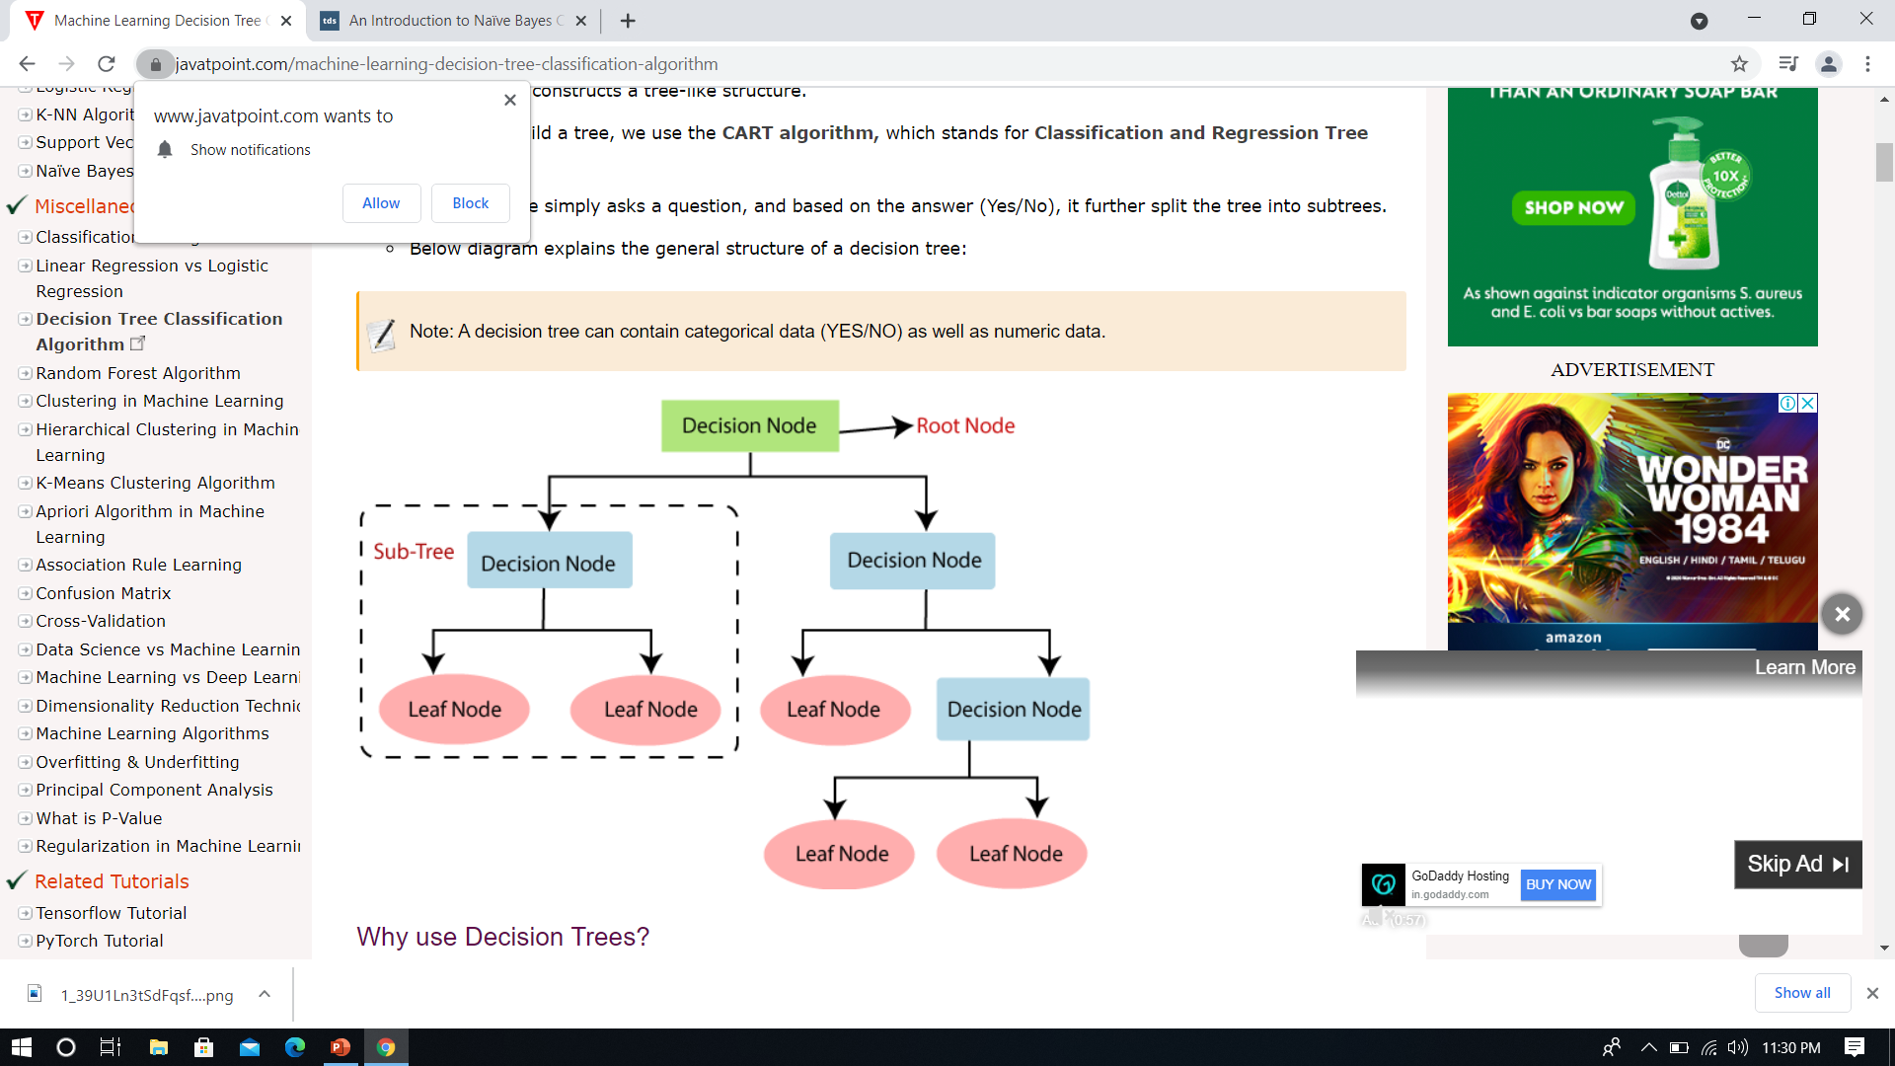
DECISION TREE CLASSIFIER
It is a type of supervised learning algorithm that is mostly used for classification problem.
A Decision Tree is a simple representation for classifying examples
It is a Supervised Machine Learning where the data is continuously split according to a certain parameter

Slide 19
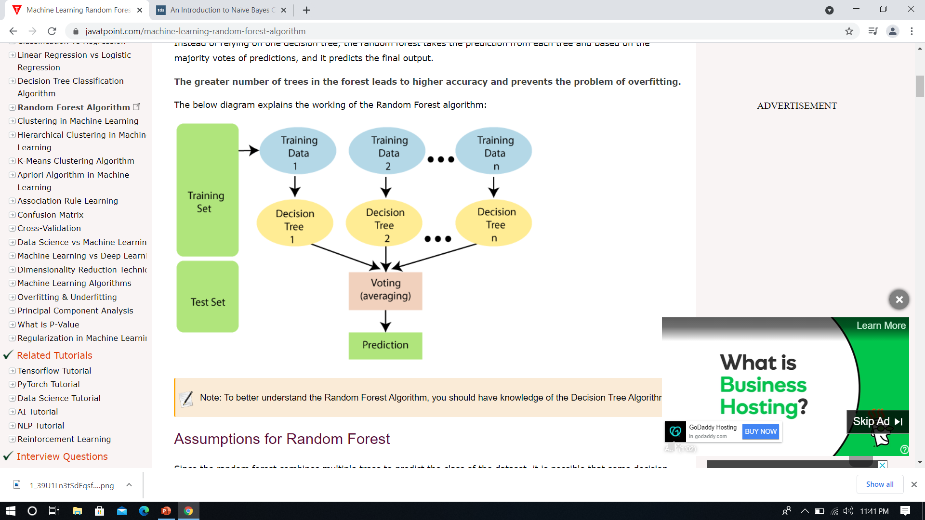
RANDOM FOREST CLASSIFIER
Random Forest is a tree based classification algorithm.
As the name indicates , the algorithm creates a forest with a large number of trees.
It creates a set of Decision Trees from a random sample of the training set

Slide 20
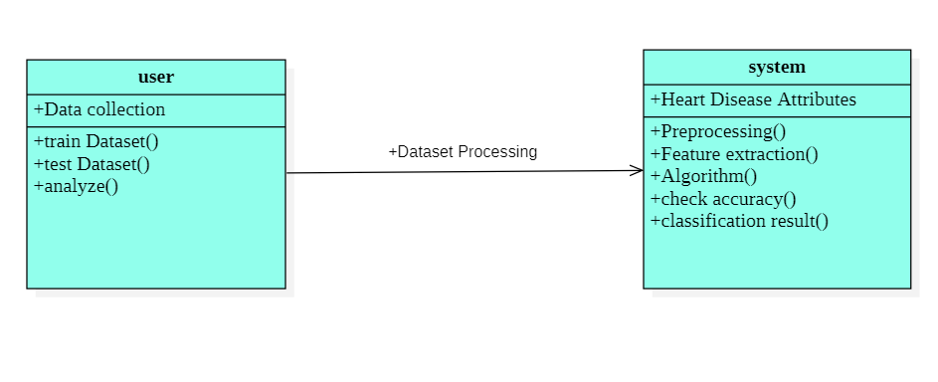
SYSTEM DESIGN
UML DIAGRAMS
1.CLASS DIAGRAM

Slide 21
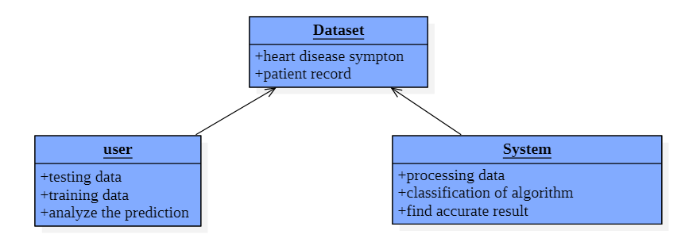
2. OBJECT DIAGRAM

Slide 22
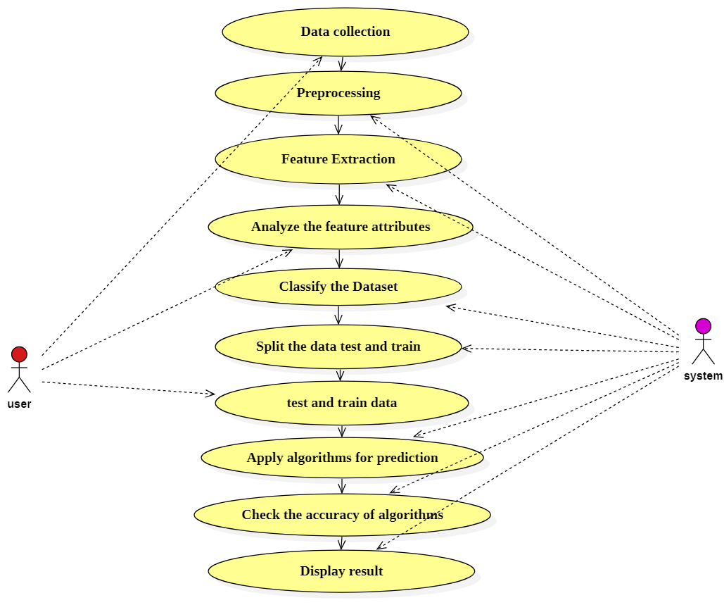
3.USECASE DIAGRAM

Slide 23
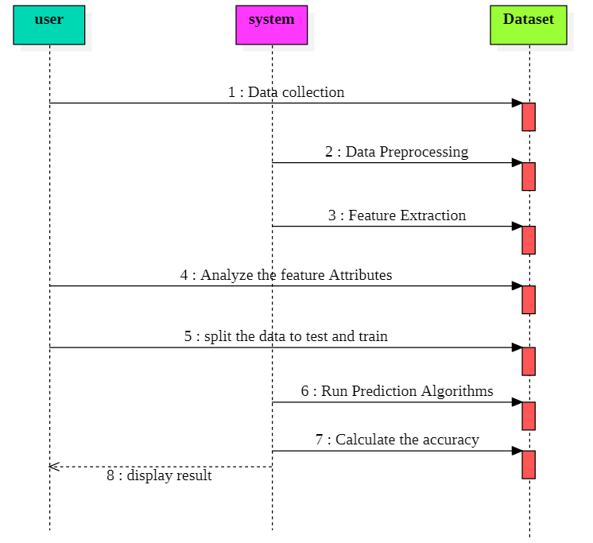
4.SEQUENCE DIAGRAM

Slide 24
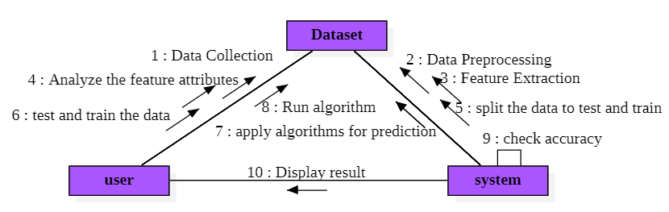
5. COMMUNICATION DIAGRAM

Slide 25
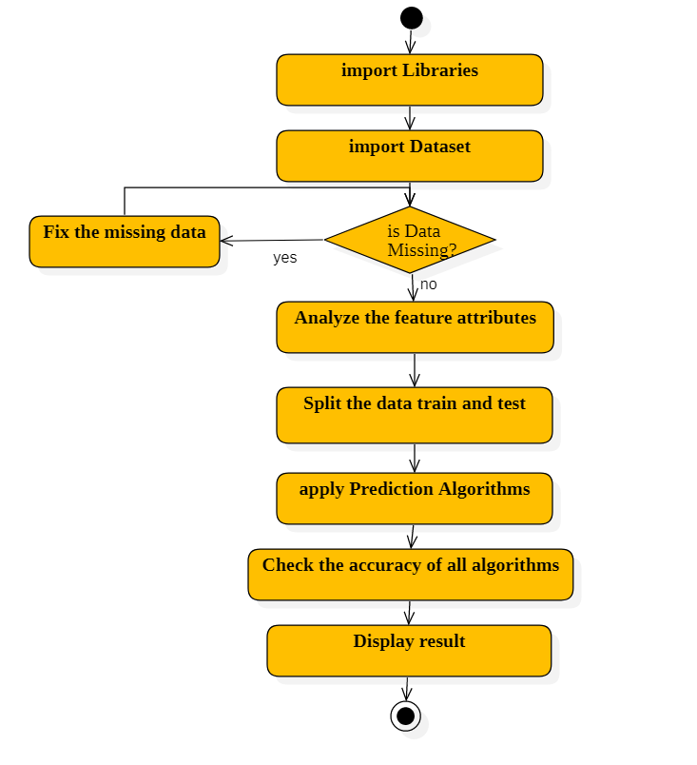
6. ACTIVITY DIAGRAM

Slide 26
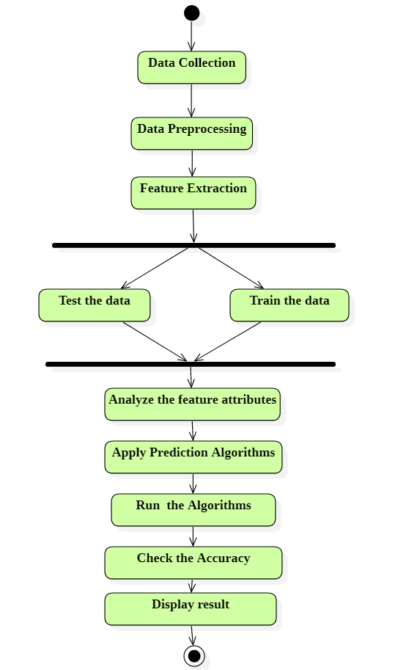
7. STATECHART DIAGRAM

Slide 27
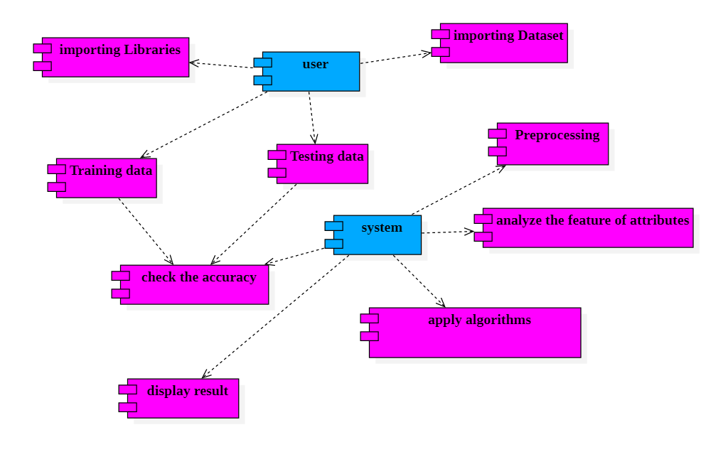
8. COMPONENT DIAGRAM

Slide 28
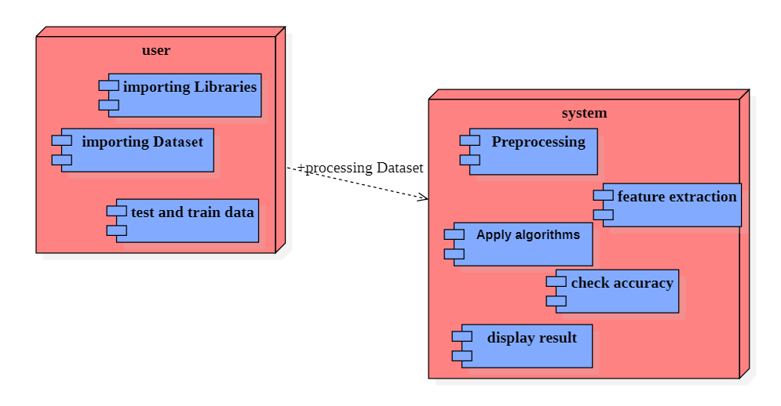
9.DEPLOYMENT DIAGRAM

Slide 29

SYSTEM TESTING
Functional Testing
Integration Testing

Slide 30
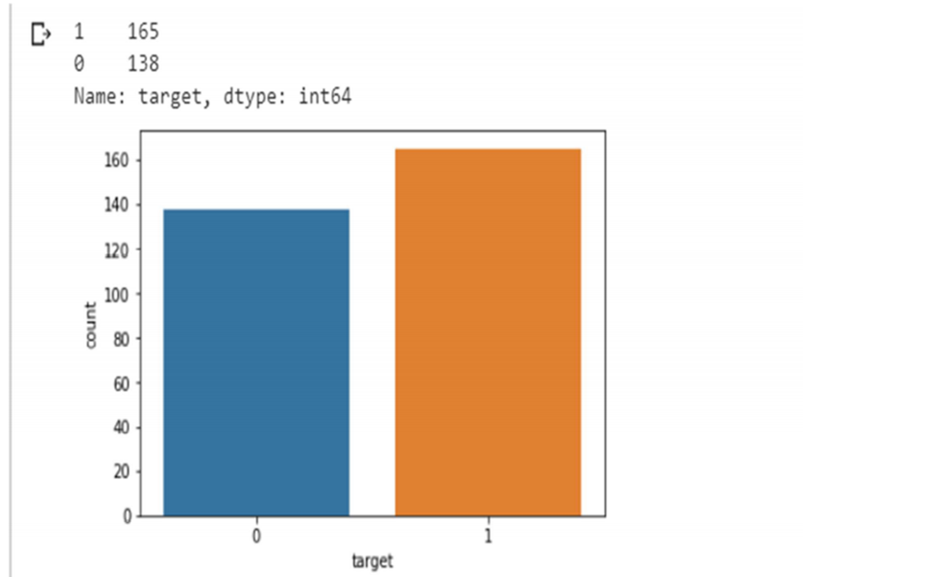
OUTPUT SCREEN
1.ANALYSING TARGET
DISEASE VS NON-DISEASE

Slide 31
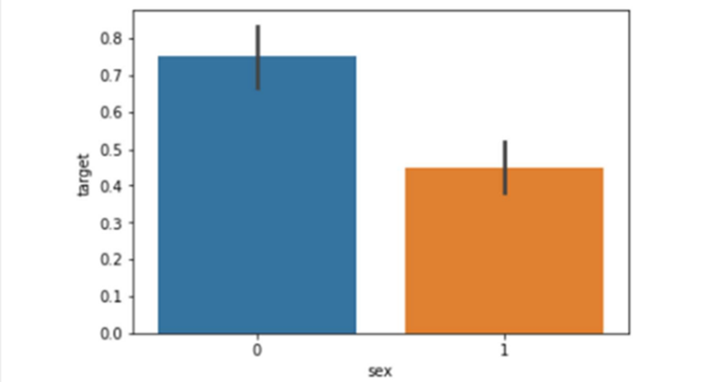
2.ANALYSIS OF SEX

Slide 32
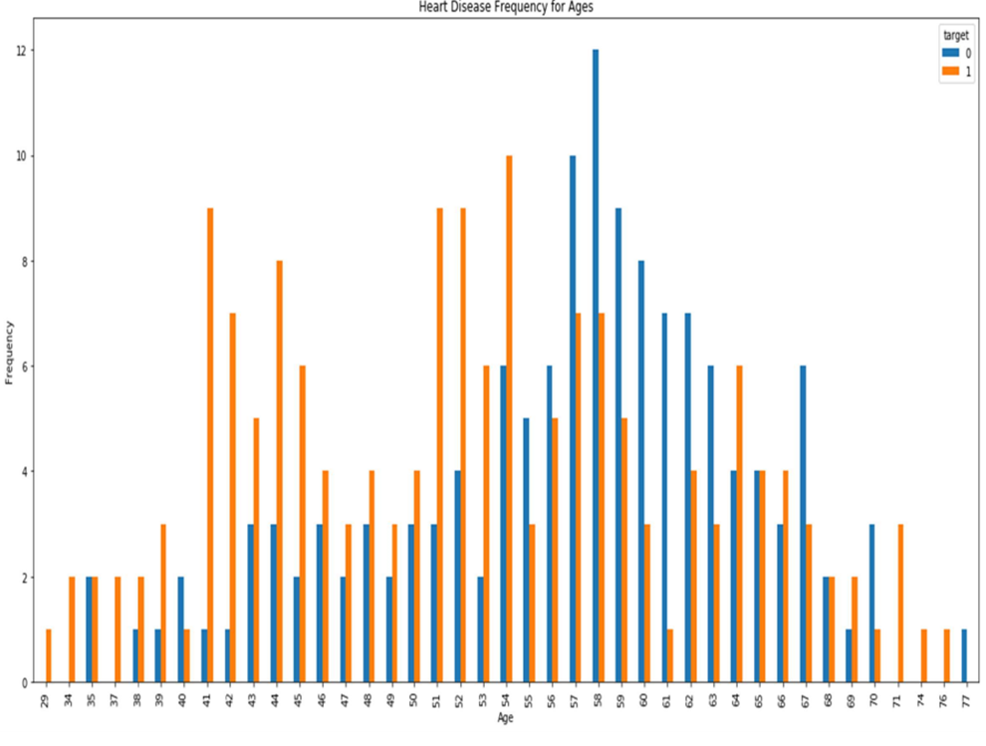
3.ANALYSIS OF HEART DISEASE FREQUENCY FOR AGES

Slide 33
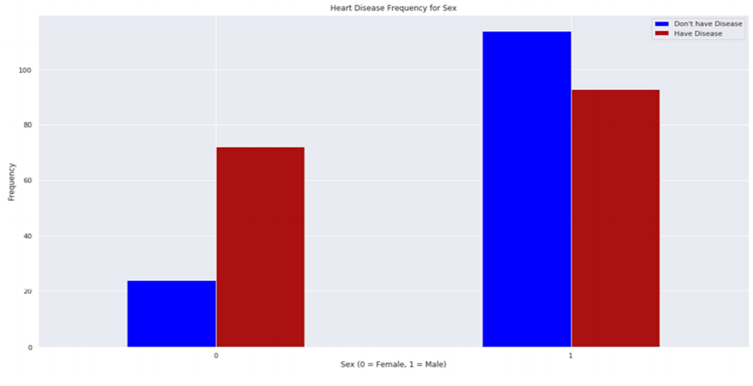
4.ANALYSIS OF HEART DISEASE FREQUENCY FOR SEX

Slide 34
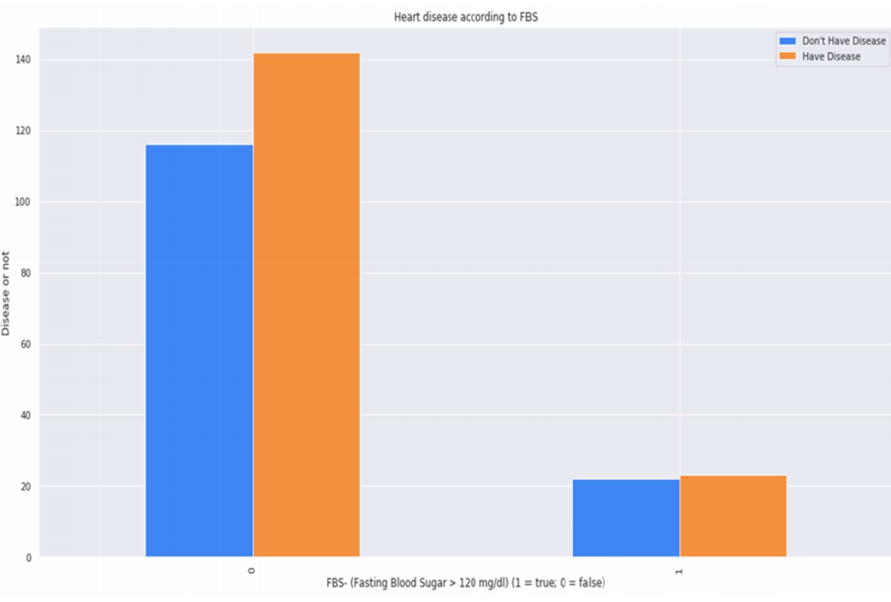
5.ANALYSIS HEART DISEASE ACCORDING TO FAST BLOOD SUGAR

Slide 35
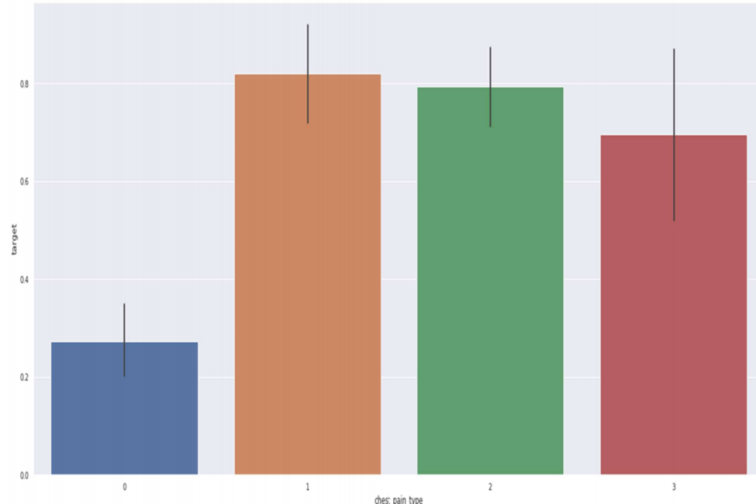
6.ANALYSIS OF CHEST PAIN TYPE

Slide 36
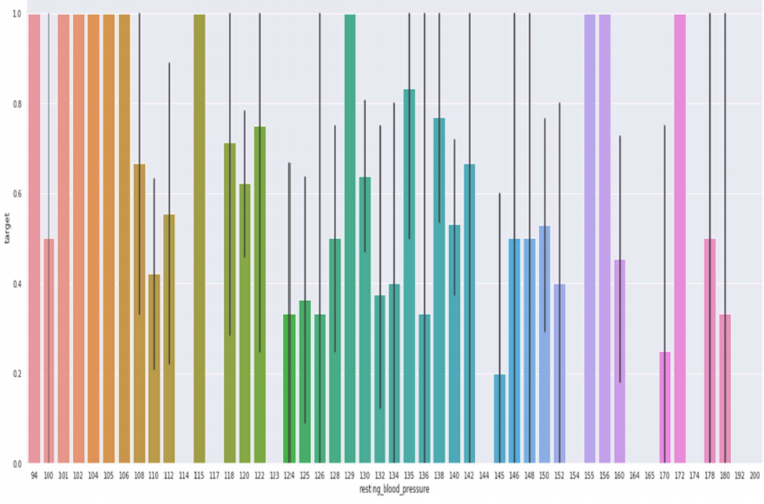
7.ANALYSIS OF RESTING BLOOD PRESSURE

Slide 37
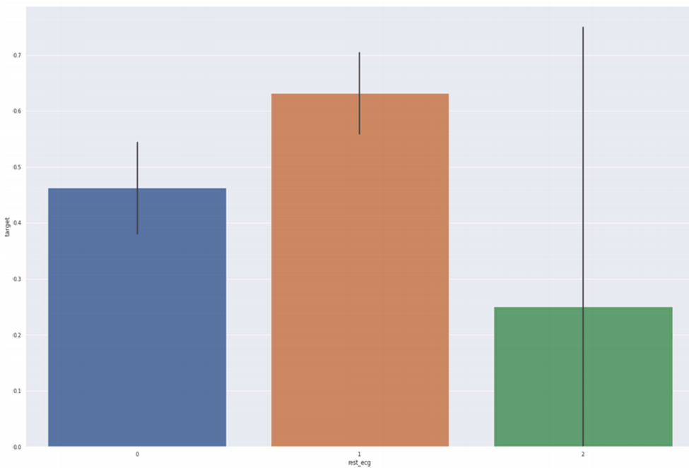
8.ANALYSING ECG

Slide 38
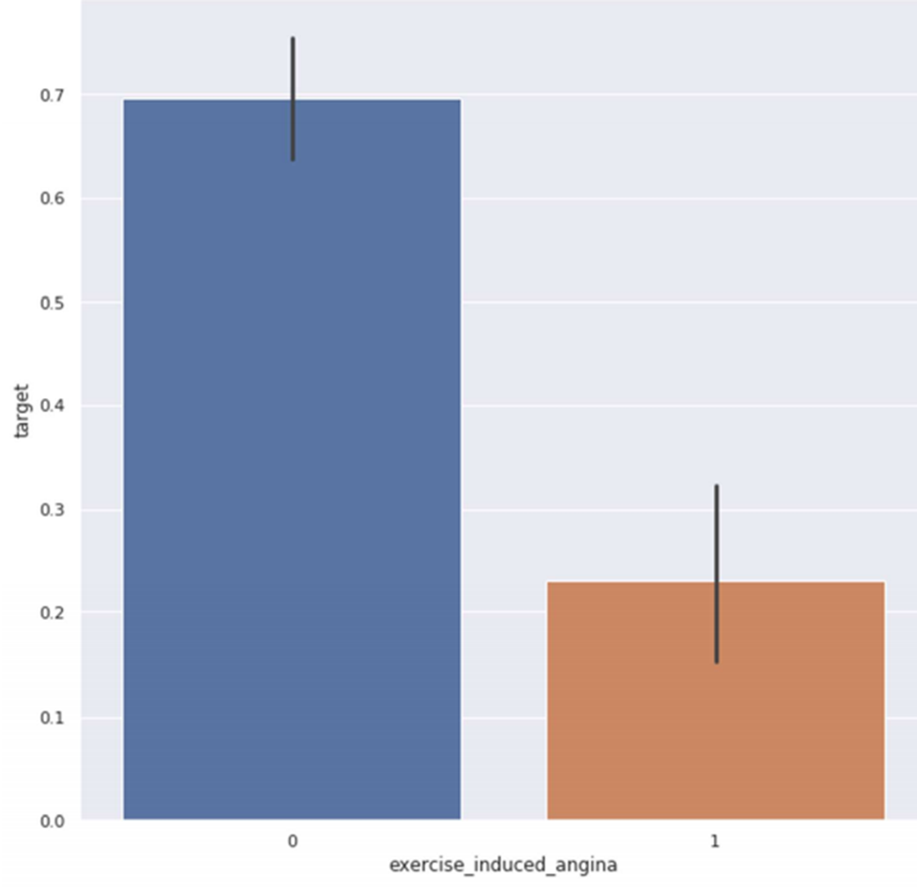
9.ANALYSING EXERCISE INCUCED ANGINA

Slide 39
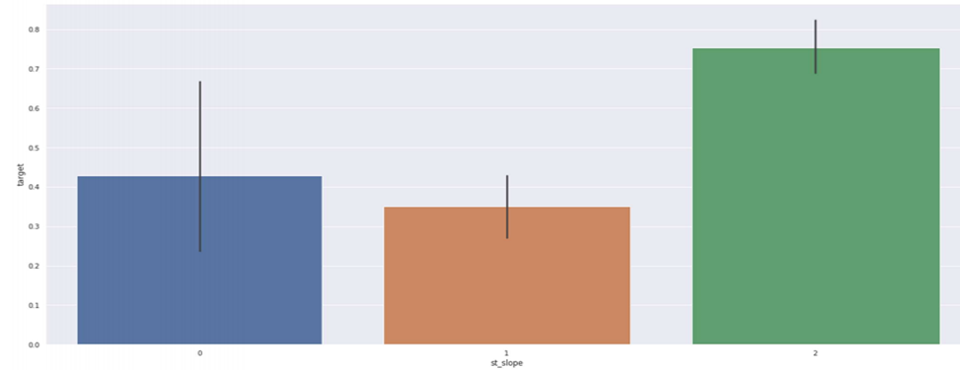
10.ANALZING ST-SLOPE

Slide 40
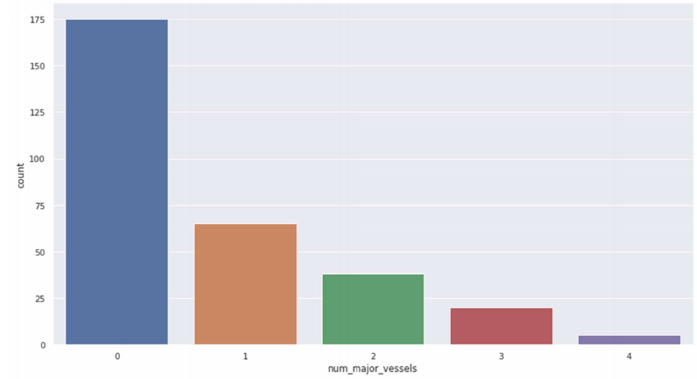
11.ANALYZING NO OF MAJOR VESSELS

Slide 41
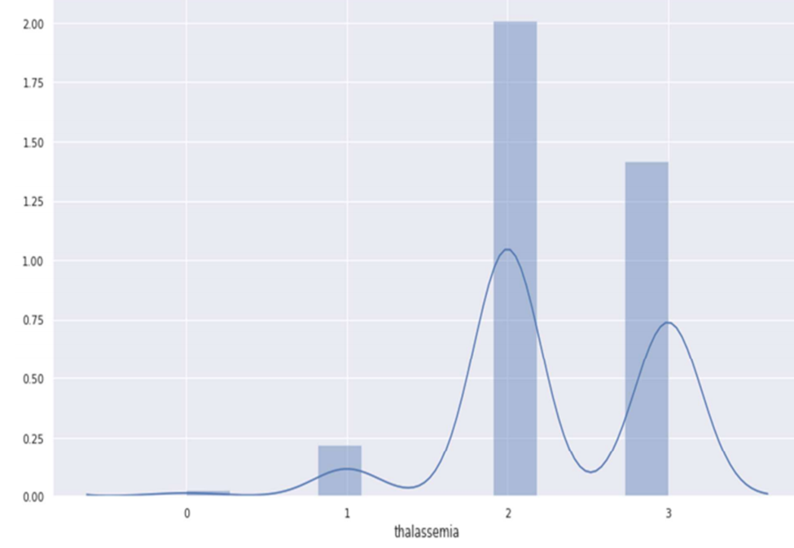
12.THALASSEMIA DISTRIBUTION

Slide 42
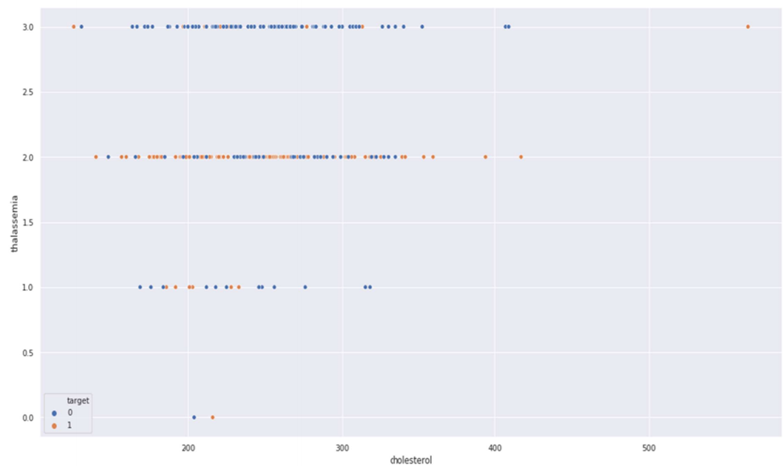
13.THALASSEMIA VS CHOLESTROL

Slide 43
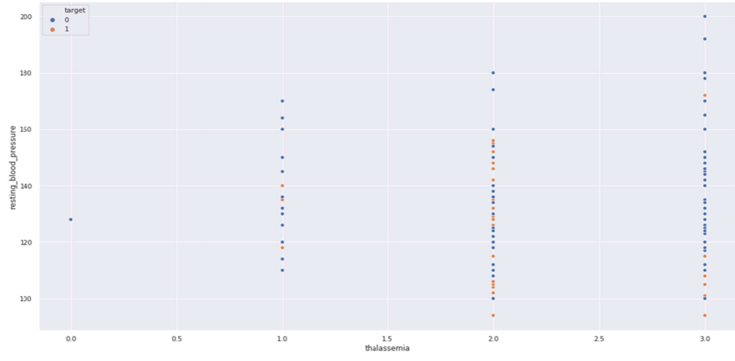
14.THALASSEMIA VS RESTING_BLOOD_PRESSURE

Slide 44
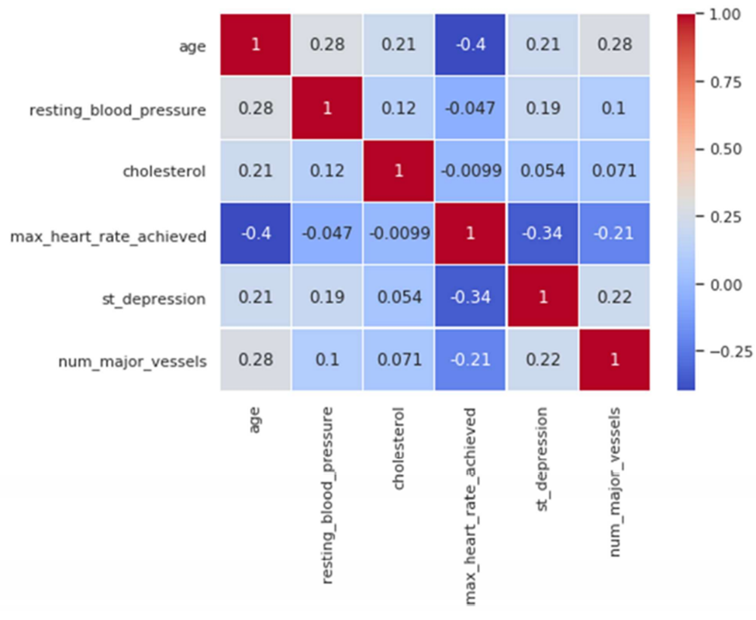
15.CORRELATION MATRIX

Slide 45
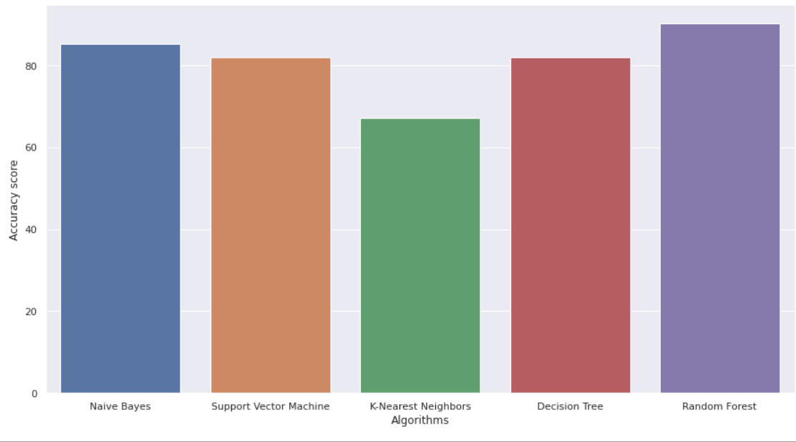
16.ACCURACY SCORE OF ALL ALGORITHMS

Slide 46

Processor: Pentium IV or higher
RAM: 256 MB
Space on hard disk: minimum 512mb
HARDWARE REQUIREMENTS

Slide 47




SOFTWARE REQUIREMENTS
Python
Anaconda Navigator
Jupyter notebook
Operating system : Windows
Debugger and Emulator
▪ Any Browser (Particular Chrome)

Slide 48

APPLICATIONS
It utilizes the data such blood pressure , cholesterol, diabetes and then tries to predict the possible heart disease in patients.
This may help in taking preventive measures and hence can try to avoid the possibility of heart disease in patient.
So , when a patient is predicted as positive for heart disease, then the medical data for the patient can be closely analyses by the doctors
It will used by many researchers , in health care industry, professionals.

Slide 49

CONCLUSION
With the increasing number of deaths due to heart diseases , it has become mandatory to develop a system to predict heart diseases effectively and accurately.
The motivation for the study was to find the most efficient ML algorithm for detection of heart diseases.
This study compares the accuracy score of Decision Tree, K-Nearest Neighbour, Random Forest and Naive Bayes algorithms for predicting heart disease using dataset.
This analysis provide better results and help health professionals in predicting the heart disease effectively and efficiently.

Slide 50




